Slide 1

Environmental Analysis
Co-Sub
Co-Sub
21102052 Lee Jeong-yun | 21102044 Oh Seyeon | 21102050 Lee Insun

Slide 2


Contents
1.
About Co-Sub
Our Item
a.
b.
Perspective in the Analysis
c.
Adopted Technologies
d.
Current Status and Prospects
2.
a.
Customer Analysis
Market
Analysis
b.
Competitors Analysis
c.
Market Analysis
d.
Regulations

Slide 3
Co-Sub
Our Item : Co-Sub
21102052 Lee Jeong-yun | 21102044 Oh Seyeon | 21102050 Lee Insun

Slide 4
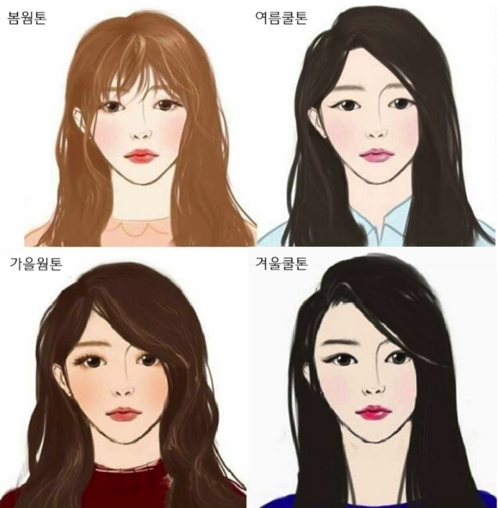
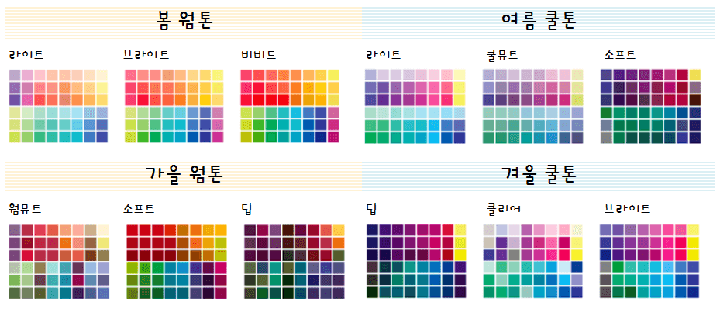
Our Item
1.
About Co-Sub
Motivation
What is personal color?
: Color that best matches the color of the individual's body
Notes:
퍼스널 컬러 정의:
개인이 가진 신체의 색과 어울리는 색. 사용자에게 생기가 돌고 활기차 보이도록 연출하는 이미지 관리 따위에 효과적이다.

Slide 5

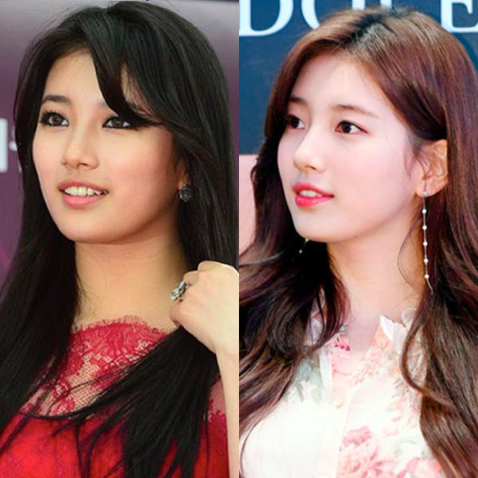
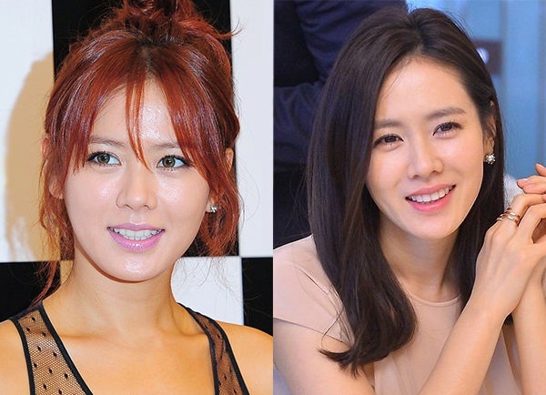
Our Item
1.
About Co-Sub
Motivation
Personal color can help people to makeup very suitable.
Notes:
1. 사진 예시
-> 퍼스널 컬러를 알면 자신에게 어울리는 최적의 Makeup을 할 수 있음
2. 많은 사람들이 자신에게 어울리는 립제품을 찾고자 많은 돈을 사용한다는 것을 알게됨
-> We want to reduce the cost to find best lip color
월정액을 지불해 퍼스널 컬러를 진단받고, 이를 기반한 메이크업 제품 구입을 도와줄 것을 다짐함.
평균 색조 화장품 개수 뷰티누리 - 화장품신문 (Beautynury.com) :: 2040 여성들 색조 화장품 평균 4개 사용…입술 화장 중시

Slide 6
Our Item
1.
About Co-Sub
Motivation
Average Number of Color Cosmetics | 20s | 30s | 40s
 | 5.2 | 3.8 | 3.1
People value the ‘Lip’ as the
Most Important Part of Makeup!
2040 여성들 색조 화장품 평균 4개 사용…입술 화장 중시, Beautynuri, 2019, Https://www.beautynury.com/m/news/view/83430
Notes:
1. 사진 예시
-> 퍼스널 컬러를 알면 자신에게 어울리는 최적의 Makeup을 할 수 있음
2. 많은 사람들이 자신에게 어울리는 립제품을 찾고자 많은 돈을 사용한다는 것을 알게됨
-> We want to reduce the cost to find best lip color
월정액을 지불해 퍼스널 컬러를 진단받고, 이를 기반한 메이크업 제품 구입을 도와줄 것을 다짐함.
평균 색조 화장품 개수 뷰티누리 - 화장품신문 (Beautynury.com) :: 2040 여성들 색조 화장품 평균 4개 사용…입술 화장 중시

Slide 7
Our Item
1.
About Co-Sub
Overview
2
Hunt Personal Color by AI Analysis
Providing various cosmetics until the user finds the preferred colors and the textures
Experience recommended products based on the result
Cosmetic Subscription Service
1
3
Notes:
ai기술로 퍼스널컬러를 진단받고 이를 바탕으로 추천받은 립 제품들을 체험해볼 수 있는 화장품 구독 서비스입니다.
사용자가 구독하면 자신에게 어울리는 립 제품의 색상과 텍스쳐를 발견할 때까지 일정 기간 동안 다양한 색상의 틴트를 제공합니다.

Slide 8

Our Item
1.
About Co-Sub
Target Group
People who haven’t
Found the Proper Lip Color and Texture for them.
Notes:
타겟층 :
자신에게 맞는 립 색상과 텍스쳐를 발견하지 못한 사람들
화장품 관련 소식을 알고 싶은 사람들
피부 건강을 위해 화장품 유통기한에 관심이 있는 사람들

Slide 9







Our Item
1.
About Co-Sub
What Services?
1) Cosmetic Subscription Service Based on AI
Uploading Selfie Without Makeup
Analysis of Personal Color
and Lip Color Based on AI
Select the Product from
the List of Recommended Products
Delivery and Experience the Products
Notes:
AI기반 화장품 구독서비스
- 해당 서비스에 화장을 하지 않은 자신의 얼굴 사진을 업로드 합니다. 그러면 퍼스널 컬러 분석 결과를 데이터로 가지고 있는 AI가 사용자에게 어울리는 립 색상을 분석합니다. 그 다음 맞춤형 립 제품들로 이루어진 리스트를 보여주고, 리스트 중 고객이 사용하고 싶은 제품을 2개 선택합니다. 그러면 저희의 서비스가 해당 제품을 배송해줍니다. 그러면 고객은 립 제품들을 체험 후 리뷰를 작성합니다.
퍼스널 컬러 기반 화장품 진단 서비스
- 빅데이터를 사용해 화장품들을 퍼스널 컬러에 맞춰 분류합니다. 그리고 사용자가 진단 받고 싶은 화장품의 이름과 호수를 검색하면, 해당 화장품이 사용자의 퍼스널컬러에 적합한지 판단해줍니다.
화장품 사용기한 알림 서비스
- 화장품들은 모두 유통기한을 가지고 있습니다. 제품을 구입시 사용자가 마이페이지에 들어가 구입한 화장품의 개봉날짜를 적으면 화장품 유통기한의 만료일 전에 사용자에게 알림을 울려줍니다.
커뮤니티 플랫폼
화장품에 관련된 다양한 콘텐츠들이 펼쳐집니다. 화장품 리뷰, 화장품을 가지고 만드는 쇼츠 영상, 화장품 게임, 화장품 웹툰 등 화장품에 관심있는 사람들이 화장품을 주제로 소통할 수 있는 커뮤니티 플랫폼입니다.

Slide 10
Our Item
1.
Perspective of Analysis
Virtual Company,
‘ ’
Co-Sub
Co-Sub | Make an Economic Profit by subscription fee from user
Our Partners | Can Promote their products
Users | Can find Fit Cosmetic Products Get Information about cosmetics from the Community
Notes:
Perspective in the analysis: Virtual company ‘Co-Sub’
- Necessity of business (표)
Co-Sub : Make an economic profit by subscription fee from user
Cooperative cosmetic companies: Be able to promote their product
User: Be able to find fit cosmetic products, Get information about cosmetics in community plattform

Slide 11


Our Item
1.
Adopted Technologies
AI Analysis
Big-data Analysis
Notes:
AI analysis: 퍼스널컬러를 진단할 때 사용
Bigdata analysis: 화장품이 사용자의 퍼스널컬러에 적합한지 판단할 때 사용
사용자의 수요를 파악해 개인의 노력을 감소시키고 그만큼 부가가치를 창출하는 것이 컬러버랩의 핵심 목표

Slide 12
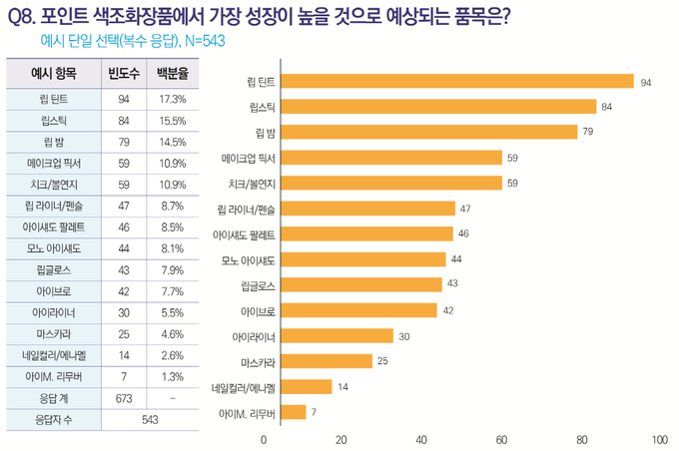
Our Item
1.
Current Status
Lip Products Have
High Growth Potential
[2022 신년특집] 2022년 화장품업계 트렌드와 이슈는? (cosinkorea.com)
Notes:
색조 화장품 중에서 립 제품이 가장 성장가능성이 높다.

Slide 13
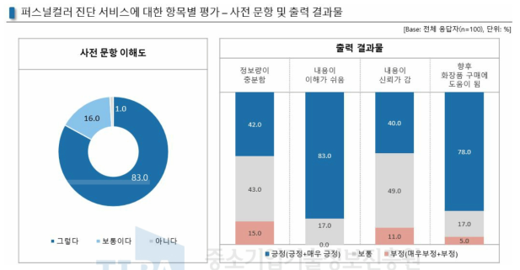
Our Item
1.
Prospects
[보고서]AR기반의 스마트미러 장치를 활용한 퍼스널 컬러 진단 및 제품 추천 서비스 (kisti.re.kr)
Personal Color Helps People Select Cosmetics
Notes:
퍼스널컬러 진단은 사람들이 화장품을 선택하는 것에 도움이 됨

Slide 14
Our Item
1.
Prospects
Average Cost = 92258.5 Won
Expensive Test from the Human Experts

Slide 15
Our Item
1.
Prospects
Result :
Selecting Lip Products with the Highest
Growth Potential
‘ ’
Co-Sub
Reducing the cost of hunting personal colors
Notes:
결론: ‘cosub’은 색조 화장품 중에서 성장 가능성이 가장 높은 립 제품을 주요 상품으로 선정
또한 화장품 선택에 도움이 되는 퍼스널컬러 진단 비용을 절감할 수 있어 미래가 밝다

Slide 16
Co-Sub
Market
21102052 Lee Jeong-yun | 21102044 Oh Seyeon | 21102050 Lee Insun

Slide 17
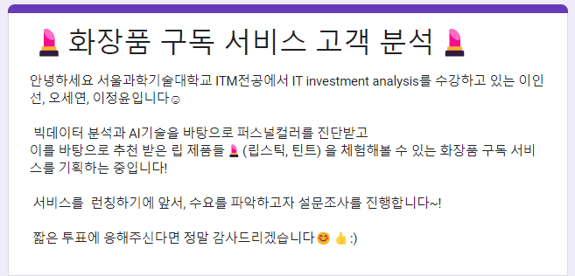
Market
2.
Consumer Analysis
Purpose
Period : 2022. 09.26~2022.10.01
A Number of participants : 68
1) To find out the number of people who experience personal color experience.
2) To find out the number of people who experienced a fail to buy color cosmetics online .
3) To find out our service demand.
Notes:
목적
1) To find out the number of people who experience personal color experience
2) To find out the number of people who experienced a fail to buy color cosmetics online shopping.
3) To find out our service demand
1) 퍼스널컬러 진단 경험
2) 잭조 화장품을 온라인으로 구매했을때 실패했던 경험 여부 파악
3) 수요예측

Slide 18
Market
2.
Consumer Analysis
Result
Notes:
결론
1) 퍼스널컬러 진단 경험 →
2) 잭조 화장품을 온라인으로 구매했을때 실패했던 경험 여부 파악 →온라인 후기만으로는 자신에게 어울리는 립 제품을 찾기에 한계가 있음
3) 수요예측 →

Slide 19
Market
2.
Consumer Analysis
Result
Notes:
결론
1) 퍼스널컬러 진단 경험 →
2) 잭조 화장품을 온라인으로 구매했을때 실패했던 경험 여부 파악 →온라인 후기만으로는 자신에게 어울리는 립 제품을 찾기에 한계가 있음
3) 수요예측 →

Slide 20
Market
2.
Consumer Analysis
Result
‘ ’
Co-Sub
Notes:
결론
1) 퍼스널컬러 진단 경험 →
2) 잭조 화장품을 온라인으로 구매했을때 실패했던 경험 여부 파악 →온라인 후기만으로는 자신에게 어울리는 립 제품을 찾기에 한계가 있음
3) 수요예측 →

Slide 21
Market
2.
Competitors Analysis
 | OLIVE YOUNG | Hwahae | Zamface | Co-Sub
# Users | 100M | 100M | 10M | Unpredictable
Cost | 13,310 Won (Average of TOP 10 Lip) | 9,940 Won (Average of Top 10 Lip) | 10,105 Won (Average of Top 10 Lip) | Under 9,940 Won per Quarter
How to Experience | Offline Shop | X | X | Regular Delivery
Personal Color | X | X | O | O
Notes:
평균 가격: 11,181
3개월에 서비스 2번 이용 -> 제품 1개씩 배송

Slide 22
Market
2.
Cost
Competitiveness
Market Analysis
Positioning Map
Cosub
HWAHAE
Zam face
Personal Color
Olive
young

Slide 23
Market
2.
Market Analysis
Five Force’s Model
Competitive
Rivalry
Threats of new entry
Buyer power
Threats of substitutes
Supplier power
Notes:
Substitute
- The method of offline lip color testing requires effort
No service to completely replace the experience subscription service of 'COSUB’.
Supplier power
All cosmetics companies that sell lip products are suppliers -> Many alternative suppliers
Supplier's sales can increase due to product promotion effect by using 'COSUB' -> Supplier engagement is high
Excluding inflation, the price of cosmetics sold is constant -> Low possibility of change in unit price of supply products
Competitive Rivalry
Big difference in the way of experience from existing cosmetics companies -> Low competition
Threats of new entry
- Agreements with various cosmetics brands, data on personal color analysis, and AI development costs are required → High entry barriers
- Not only purchasing cosmetics but also accessing various contents related to cosmetics through the community service --> High brand loyalty
Buyer power
- According to statistics that an average of four lip products are used per person, two products are used for one subscription to COSUB, and two subscriptions are expected per person
- Unable to replace 'COSUB' from the buyer's point of view
- Experiencing a variety of colors at the same price -> Having a value to pay price from the buyer's point of view

Slide 24
Market
2.
Market Analysis
Five Force’s Model
Competitive
Rivalry
Threats of new entry
Buyer power
Threats of substitutes
Supplier power
Competitive Rivalry
Big difference in the way of experience from existing cosmetics companies
→ Low competition
Notes:
Substitute
- The method of offline lip color testing requires effort
No service to completely replace the experience subscription service of 'COSUB’.
Supplier power
All cosmetics companies that sell lip products are suppliers -> Many alternative suppliers
Supplier's sales can increase due to product promotion effect by using 'COSUB' -> Supplier engagement is high
Excluding inflation, the price of cosmetics sold is constant -> Low possibility of change in unit price of supply products
Competitive Rivalry
Big difference in the way of experience from existing cosmetics companies -> Low competition
Threats of new entry
- Agreements with various cosmetics brands, data on personal color analysis, and AI development costs are required → High entry barriers
- Not only purchasing cosmetics but also accessing various contents related to cosmetics through the community service --> High brand loyalty
Buyer power
- According to statistics that an average of four lip products are used per person, two products are used for one subscription to COSUB, and two subscriptions are expected per person
- Unable to replace 'COSUB' from the buyer's point of view
- Experiencing a variety of colors at the same price -> Having a value to pay price from the buyer's point of view

Slide 25
Market
2.
Market Analysis
Five Force’s Model
Competitive
Rivalry
Threats of new entry
Buyer power
Threats of substitutes
Supplier power
Threats of new entry
- Agreements with various cosmetics brands, data on personal color analysis, and AI development costs are required → High entry barriers
Notes:
Substitute
- The method of offline lip color testing requires effort
No service to completely replace the experience subscription service of 'COSUB’.
Supplier power
All cosmetics companies that sell lip products are suppliers -> Many alternative suppliers
Supplier's sales can increase due to product promotion effect by using 'COSUB' -> Supplier engagement is high
Excluding inflation, the price of cosmetics sold is constant -> Low possibility of change in unit price of supply products
Competitive Rivalry
Big difference in the way of experience from existing cosmetics companies -> Low competition
Threats of new entry
- Agreements with various cosmetics brands, data on personal color analysis, and AI development costs are required → High entry barriers
- Not only purchasing cosmetics but also accessing various contents related to cosmetics through the community service --> High brand loyalty
Buyer power
- According to statistics that an average of four lip products are used per person, two products are used for one subscription to COSUB, and two subscriptions are expected per person
- Unable to replace 'COSUB' from the buyer's point of view
- Experiencing a variety of colors at the same price -> Having a value to pay price from the buyer's point of view

Slide 26
Market
2.
Market Analysis
Five Force’s Model
Competitive
Rivalry
Threats of new entry
Buyer power
Threats of substitutes
Supplier power
Supplier power
All cosmetics companies that sell lip products are suppliers → Many alternative suppliers
Supplier's sales can increase due to product promotion effect by using 'COSUB' -> Supplier engagement is high
Excluding inflation, the price of cosmetics sold is constant
→ Low possibility of change in unit price of supply products
Notes:
Substitute
- The method of offline lip color testing requires effort
No service to completely replace the experience subscription service of 'COSUB’.
Supplier power
All cosmetics companies that sell lip products are suppliers -> Many alternative suppliers
Supplier's sales can increase due to product promotion effect by using 'COSUB' -> Supplier engagement is high
Excluding inflation, the price of cosmetics sold is constant -> Low possibility of change in unit price of supply products
Competitive Rivalry
Big difference in the way of experience from existing cosmetics companies -> Low competition
Threats of new entry
- Agreements with various cosmetics brands, data on personal color analysis, and AI development costs are required → High entry barriers
- Not only purchasing cosmetics but also accessing various contents related to cosmetics through the community service --> High brand loyalty
Buyer power
- According to statistics that an average of four lip products are used per person, two products are used for one subscription to COSUB, and two subscriptions are expected per person
- Unable to replace 'COSUB' from the buyer's point of view
- Experiencing a variety of colors at the same price -> Having a value to pay price from the buyer's point of view

Slide 27
Market
2.
Market Analysis
Five Force’s Model
Competitive
Rivalry
Threats of new entry
Buyer power
Threats of substitutes
Supplier power
Threat of substitute
- The method of offline lip color testing requires effort
- No service to completely replace the experience subscription service of 'COSUB’.
Notes:
Substitute
- The method of offline lip color testing requires effort
No service to completely replace the experience subscription service of 'COSUB’.
Supplier power
All cosmetics companies that sell lip products are suppliers -> Many alternative suppliers
Supplier's sales can increase due to product promotion effect by using 'COSUB' -> Supplier engagement is high
Excluding inflation, the price of cosmetics sold is constant -> Low possibility of change in unit price of supply products
Competitive Rivalry
Big difference in the way of experience from existing cosmetics companies -> Low competition
Threats of new entry
- Agreements with various cosmetics brands, data on personal color analysis, and AI development costs are required → High entry barriers
- Not only purchasing cosmetics but also accessing various contents related to cosmetics through the community service --> High brand loyalty
Buyer power
- According to statistics that an average of four lip products are used per person, two products are used for one subscription to COSUB, and two subscriptions are expected per person
- Unable to replace 'COSUB' from the buyer's point of view
- Experiencing a variety of colors at the same price -> Having a value to pay price from the buyer's point of view

Slide 28
Market
2.
Market Analysis
Five Force’s Model
Competitive
Rivalry
Threats of new entry
Buyer power
Threats of substitutes
Supplier power
Buyer power
- According to statistics that an average of four lip products are used per person, two products are used for one subscription to COSUB, and two subscriptions are expected per person
- Unable to replace 'COSUB' from the buyer's point of view
- Experiencing a variety of colors at the same price
→ Having a value to pay price from the buyer's point of view
Notes:
Substitute
- The method of offline lip color testing requires effort
No service to completely replace the experience subscription service of 'COSUB’.
Supplier power
All cosmetics companies that sell lip products are suppliers -> Many alternative suppliers
Supplier's sales can increase due to product promotion effect by using 'COSUB' -> Supplier engagement is high
Excluding inflation, the price of cosmetics sold is constant -> Low possibility of change in unit price of supply products
Competitive Rivalry
Big difference in the way of experience from existing cosmetics companies -> Low competition
Threats of new entry
- Agreements with various cosmetics brands, data on personal color analysis, and AI development costs are required → High entry barriers
- Not only purchasing cosmetics but also accessing various contents related to cosmetics through the community service --> High brand loyalty
Buyer power
- According to statistics that an average of four lip products are used per person, two products are used for one subscription to COSUB, and two subscriptions are expected per person
- Unable to replace 'COSUB' from the buyer's point of view
- Experiencing a variety of colors at the same price -> Having a value to pay price from the buyer's point of view

Slide 29
Market
2.
Market Analysis - SWOT
Strength
Weakness
Having Price Superiority
Lower Awareness than the Competitors
Lower Cost of Checking Personal Color
New Demands Except for Lip Products
Personal Data Based Recommendation
Secure Various Brands and Products
Opportunity
Threat
Steep Development of the Cosmetic Industry
Similar Service from Cosmetic Makers
Vogue for Individualized Makeup
Continuous Increase in Distribution Cost
Popularized Subscription Services
Pressure by Existing Retail Business

Slide 30

Market
2.
Regulations
Cosmetic Regulatory Framework in Korea. (2020). MFDS.
Ministry of Food and
Drug Safety
Cosmetics Act
Enforcement Rule of
Cosmetics Act
MFDS Notification
Enforcement Decree of
Cosmetics Act
Cosmetics Responsible Person Registration
Compliance with Labeling Rules
Ensuring Post-marketing Safety Management
Substantiation of Advertisement

Slide 31
Cost and Benefit Analysis
Co-Sub
Co-Sub
21102052 Lee Jeong-yun | 21102044 Oh Se-yeon | 21102050 Lee In-sun

Slide 32
Contents
1
Item Identification
- Cost Item
- Benefit Item
- Estimated Income Statement
2
Estimation Process
- Cost & Revenue Estimation Logic
3
Cash Flow

Slide 33
Item Identification
1
Cost item
Purchase
M & O
Others

Slide 34

Item Identification
1
Cost item
Purchase
Why 8?
- Quarter subscription fee
- Eight delivery per year
(per year)
Lip product (lip product unit price * User * 8)
Average prices from our investigate in Olive Young, Hwahae, Zamface = ₩ 11,118.25 per product
Olive Young’s commission ratio = 45% (http://theviewers.co.kr/View.aspx?No=1628494)
8 products per year, then total price = ₩ 11,118.25 * 8 = ₩ 88,946
Sum vendor take = ₩88,946 * (1 – 45%) = ₩ 48,920.3
‘Cosub’ need to pay more than Olive Young to vendors to have advantages!
So, we decided to pay them ₩ 50,000 per a year, ₩ 6,250 per product.
cf) slide #12

Slide 35

Item Identification
1
Cost item
Purchase
(per year)
Package material (Package unit price * User * 8)
* Package unit price = ₩ 217

Slide 36



Item Identification
1
Cost item
M & O
(per year)
Hardware (MacPro + Pro display sdr + nas storage)
= 788,770,000+52,400,000
=841,170,000
Data (Tip of personal color expert + provider )
=(10,000 + 10,000) * 50,000
= 1,000,000,000

Slide 37


Item Identification
1
Cost item
M & O
(per year)
Facility (Deposit 25,000,000, Monthly rent 21,000,000)
* Gangnam-gu, Seoul
Delivery charge (2,500 * User * 8)

Slide 38



Item Identification
1
Cost item
Developer 4 person
M & O
(per year)
Manager 2 person
Salaries (60,000,000 * 6 person) = 360,000,000
Marketing Cost (Total of commission from vendor * 0.2)

Slide 39

Item Identification
1
Cost item
가격 계산기 | Microsoft Azure
M & O
(per year)
SW Operating (Virtual machine, Database, App service, Git )
Virtual Machine | 219,693
Azure SQL Database | 537,059
App Service | 78,837
Git | 166,608
Total(Month) | 1,002,197
Total (year)
: 12,026,364

Slide 40
Item Identification
1
Cost item
Others
(per year)
* NH Bank : 5.28%
Interest (Debt * Debt interest rate)
Internet, Electricity = 200,000 + 300,000 = 500,000
Tax (Taxible income * Progressive tax rate)
( * Taxible income = GI – OE – D )

Slide 41
Item Identification
1
Benefit Item
Vendor Commission
Subscription Fee

Slide 42


Item Identification
1
Benefit Item
Vendor Commission
(per year)
Subscription Fee - Delivery Fee – Packaging - Purchasing product

Slide 43
Item Identification
1
Benefit Item
Vendor Commission
(per year)
Cosmetics price from vendor | ₩ 50,000
Delivery cost (twice in a quarter) | ₩ (2,500 * 8) = 10,000
Package cost | ₩ (217 * 8) = 1,736
Subscription fee per quarter | ₩ 17,500
Subscription fee per year | ₩ (17,500 * 4) = 70000
Cosub profit | ₩ 8264 = (70,000 – 50,000 – 10,000 –1736)
Cosub profit ratio | 8264 / 70,000 = 11.80%

Slide 44
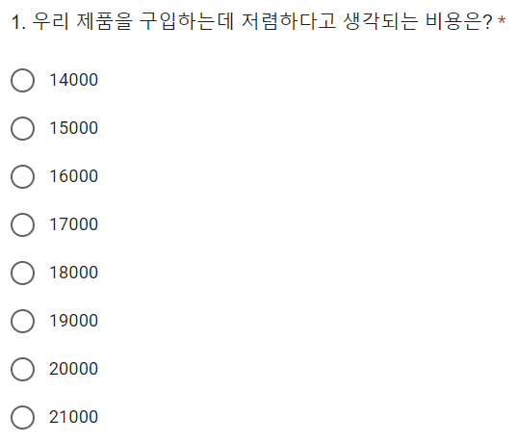
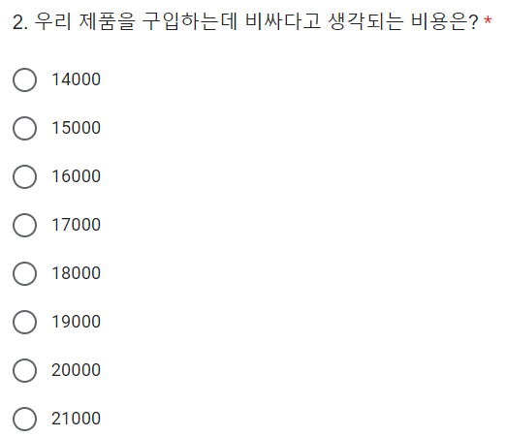
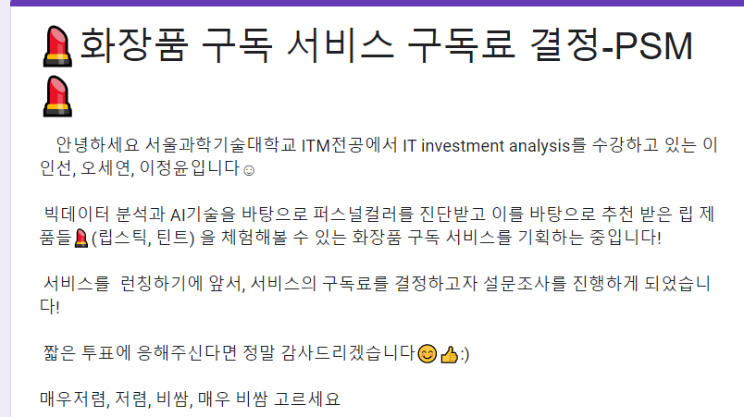
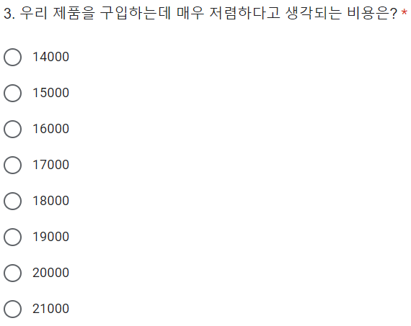
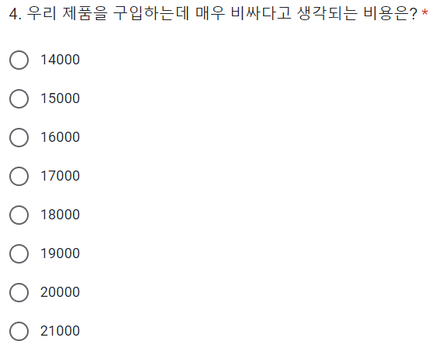
Item Identification
1
Benefit Item
Period : 2022.11.10~2022.11.13
The number of participants : 57
< Subscription Fee >
* PSM method

Slide 45
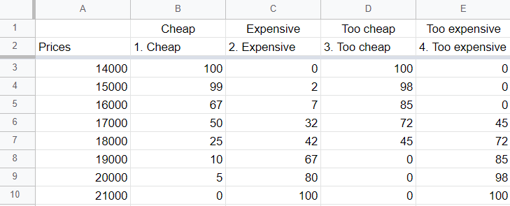
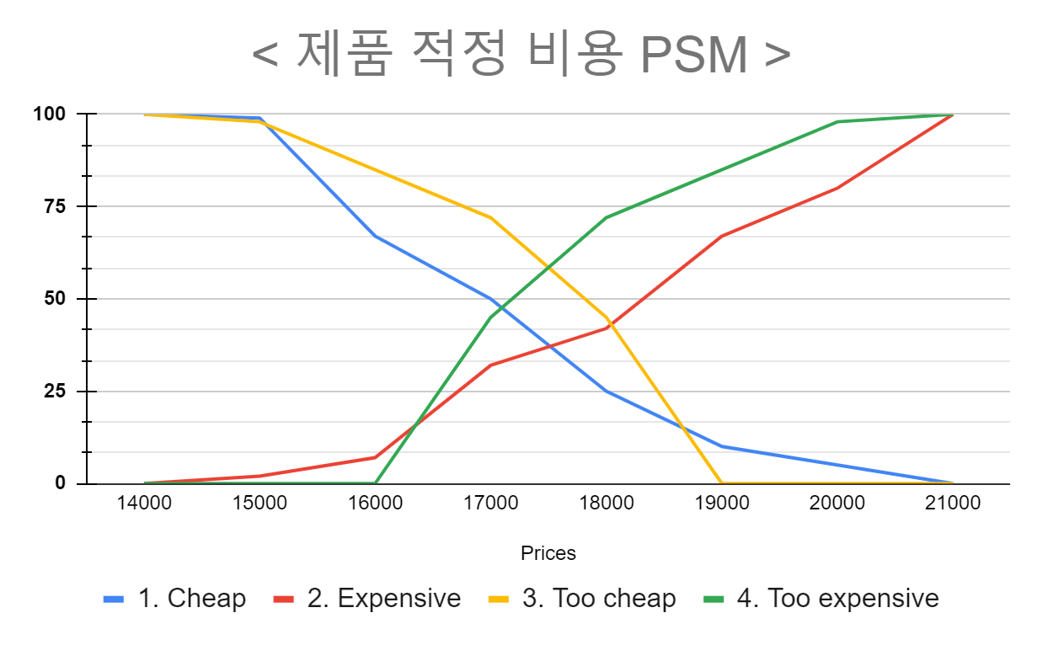
Item Identification
1
< Subscription Fee >
17,500

Slide 46
Item Identification
1
IT Performance Framework
New contract and renewal ratio of partners
Increase user repurchase rate
Self-development Support System Investment Capacity
Effectiveness
Assets management of ROI
Conversion
rate
Increment of business profit
Efficiency
Purchase cost reduction
Expanding market share in Cosmetics Sales
Increase
productivity
Sales growth rate
Operating profit growth rate
Quantitative
finance
customer
Internal process
Learning &
Growth

Slide 47
Item Identification
1
IT Performance Framework
Expand
user
selection
Employee work
experience
satisfaction
Effectiveness
Packing and
shipping satisfaction
The period
of update
Efficiency
Improved accuracy of personal-color diagnosis
qualitative
finance
customer
Internal process
Learning &
Growth

Slide 48
Item Identification
1
Estimated Income Statement
▶ First cost ◀
iMac pro + pro display xdr | 788,770,000
Nas Storage | 52,400,000
deposit | 250,000,000
Data | 1,000,000,000
Total : 2,091,170,000

Slide 49
Item Identification
1
Estimated Income Statement
▶ Depreciation item ◀
year | 0 | 1 | 2 | 3 | 4 | 5 | 6 | 7 | 8 | 9 | 10
mac | ₩ 0 | ₩ 78,877,000.00 | ₩ 78,877,000.00 | ₩ 78,877,000.00 | ₩ 78,877,000.00 | ₩ 78,877,000.00 | ₩ 78,877,000.00 | ₩ 78,877,000.00 | ₩ 78,877,000.00 | ₩ 78,877,000.00 | ₩ 78,877,000.00
storage | ₩ 0 | ₩ 5,240,000.00 | ₩ 5,240,000.00 | ₩ 5,240,000.00 | ₩ 5,240,000.00 | ₩ 5,240,000.00 | ₩ 5,240,000.00 | ₩ 5,240,000.00 | ₩ 5,240,000.00 | ₩ 5,240,000.00 | ₩ 5,240,000.00
Total | ₩ 0 | ₩ 84,117,000.00 | ₩ 84,117,000.00 | ₩ 84,117,000.00 | ₩ 84,117,000.00 | ₩ 84,117,000.00 | ₩ 84,117,000.00 | ₩ 84,117,000.00 | ₩ 84,117,000.00 | ₩ 84,117,000.00 | ₩ 84,117,000.00
Using Straight Line method
Period : 10 year

Slide 50
Item Identification
1
Estimated Income Statement
▶ Debt ◀
First cost | 2,091,170,000
Rate | 5.28%
Year | 10 year
Repayment period | 1 year

Slide 51
Item Identification
1
Estimated Income Statement
▶ Growth rate - Subscribers ◀
▶ Why the number of subscribers is 629,191 in year 6?
N = Percentage of people who have Not received personal color diagnostic experience
F = Percentage of people who have Failed to experience buy cosmetic in online shop
A = Number of downloads of Amore Pacific application in 2021
N ✕F ✕A = 629,191
▶Why did we refer to AmorePacific's number of downloads?
: AmorePacific is the company that has the largest share of the cosmetics market
▶ Except for six years, the number of subscribers in other years reflected Cosub's growth rate.

Slide 52
Item Identification
1
N
Period : 2022. 09.26~2022.10.01
A Number of participants : 68
F
Q2. 온라인에서 색조 화장품을 구매했을때,
예상과 다른 색상을 구입한 적이 있으신가요?
(ex : 예상한 것보다 채도가 더 낮았던 경험, 사진으로 본 것보다 매트한 촉감이었던 경험, 기대한 것 이상으로 밝은 색이었던 경험 등)
Q1. 퍼스널 컬러를 진단 받아본 경험이 있나요?

Slide 53
Item Identification
1
▶ Growth rate - affiliated cosmetics company ◀
▶ Number of affiliated cosmetics company in Year 0
: 500
▶ Why is the growth rate of cosmetics companies affiliated with COSUB decreasing from the 6th year?
: Because it is close to 4,750,
the largest number of cosmetics companies affiliated with COSUB.
▶ Why is the maximum number of affiliated cosmetics companies
4,750?
: The total number of brands in Olive Young is 4,750.

Slide 54
Item Identification
1
▶ Growth rate - affiliated cosmetics company ◀
▶ Why is the number of brands of cosmetics in Olive Young based on?
: Because Olive Young is the company that occupies the largest share
of the cosmetics brokerage industry.
▶ Except for 0 year, the number of affiliated cosmetics company
in other years reflected Cosub's growth rate.

Slide 55
Item Identification
1
Estimated Income Statement
▶ Number of User ◀

Slide 56
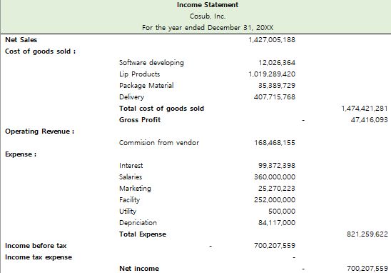
Item Identification
1
Estimated Income Statement
Year 2

Slide 57
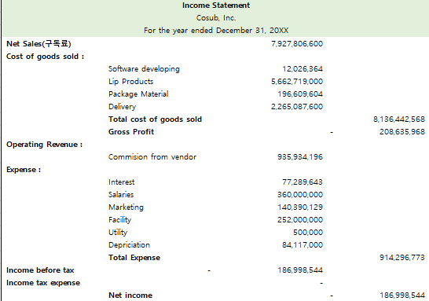
Item Identification
1
Estimated Income Statement
Year 4

Slide 58
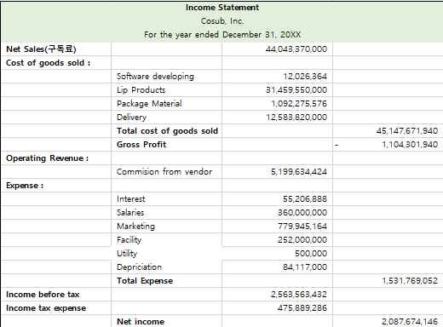
Item Identification
1
Estimated Income Statement
Year 6

Slide 59
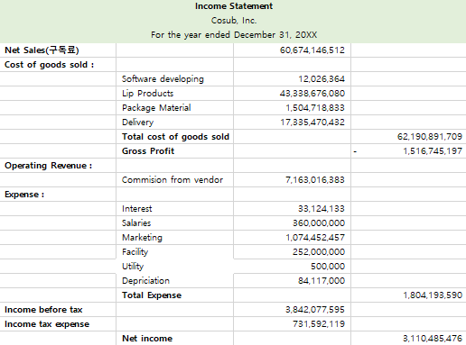
Item Identification
1
Estimated Income Statement
Year 8

Slide 60
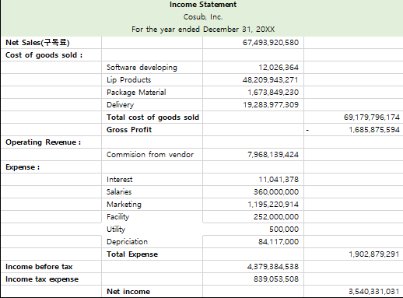
Item Identification
1
Estimated Income Statement
Year 10

Slide 61

Cash Flow
3
Cash In & Out Flow

Slide 62
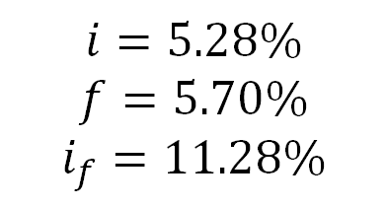
Cash Flow
3
Net Cash Flow, NPV
NPV
= ₩2,40,664,650
$$i=5.28\%$$
$$f=5.70\%$$
$$i_{f}=11.28\%$$

Slide 63
Cash Flow
3
B/C Ratio, IRR
NPV (Net present value) | ₩2,340,664,650
First Cost | ₩2,091,170,000
B/C Ratio | NPV / first cost = 1.119
IRR | 18%
> 1
> 10%
Cosub has good profitability
It satisfied with our goal IRR

Slide 64
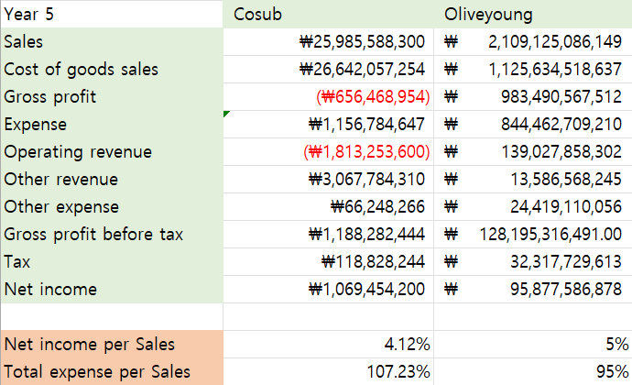
Cash Flow
3
Comparing to Olive-Young's financial statement
Financial Statements of both ‘Cosub’ and ‘Olive young’ have similar factors.

Slide 65
AHP Analysis
Co-Sub
Co-Sub
21102052 Lee Jeong-yun | 21102044 Oh Seyeon | 21102050 Lee In-sun

Slide 66
Contents
1
Decision Tree
2
Weights
3
Scores
4
Final Result

Slide 67
Decision Tree
1
Start our business
Financial
factor
Technological
factor
Service
factor
B/C ratio
Security
Optimize
AI to find
personal
color
Data
Analysis
(customer review
Convenience
Of
individual
Saving
Conversion
cost of
choosing
lip color
Expandability
Start our business
Do not Start our business

Slide 68
2
Weight - Seyeon
Overall
Financial > Technological > Service
Step 1 | Financial Factor | Technological Factor | Service Factor
Financial Factor | 1 | 3 | 5
Technological Factor | 0.333333333 | 1 | 3
Service Factor | 0.2 | 0.333333333 | 1
Total | 1.533333333 | 4.333333333 | 9
Step 4 | Consistency Vector
Financial Factor | 3.071973401
Technological Factor | 3.032968775
Service Factor | 3.011201867
Lambda | 3.038714681
Step 2 | Financial Factor | Technological Factor | Service Factor | Resulting Priorities
Financial Factor | 0.652173913 | 0.692307692 | 0.555555556 | 0.63334572
Technological Factor | 0.217391304 | 0.230769231 | 0.333333333 | 0.260497956
Service Factor | 0.130434783 | 0.076923077 | 0.111111111 | 0.106156324
Total | 1 | 1 | 1 | 1
CI of all | 0.01935734
CR of all | 0.033374725
RI | 0.58
Step 3 | Financial Factor | Technological Factor | Service Factor | Weighted Sum Vector
Financial Factor | 0.63334572 | 0.781493868 | 0.530781618 | 1.945621206
Technological Factor | 0.21111524 | 0.260497956 | 0.318468971 | 0.790082167
Service Factor | 0.126669144 | 0.086832652 | 0.106156324 | 0.31965812

Slide 69
2
Weight – Insun
Overall
Financial > Technological > Service
Step 1 | Financial Factor | Technological Factor | Service Factor
Financial Factor | 1 | 2 | 5
Technological Factor | 0.5 | 1 | 6
Service Factor | 0.2 | 0.166666667 | 1
Total | 1.7 | 3.166666667 | 12
Step 4 | Consistency Vector
Financial Factor | 3.131325871
Technological Factor | 3.108205486
Service Factor | 3.019938962
Lambda | 3.086490106
Step 2 | Financial Factor | Technological Factor | Service Factor | Resulting Priorities
Financial Factor | 0.588235294 | 0.631578947 | 0.416666667 | 0.545493636
Technological Factor | 0.294117647 | 0.315789474 | 0.5 | 0.36996904
Service Factor | 0.117647059 | 0.052631579 | 0.083333333 | 0.084537324
Total | 1 | 1 | 1 | 1
CI of all | 0.043245053
CR of all | 0.074560437
RI | 0.58
Step 3 | Financial Factor | Technological Factor | Service Factor | Weighted Sum Vector
Financial Factor | 0.545493636 | 0.73993808 | 0.422686619 | 1.708118335
Technological Factor | 0.272746818 | 0.36996904 | 0.507223942 | 1.1499398
Service Factor | 0.109098727 | 0.061661507 | 0.084537324 | 0.255297558

Slide 70
2
Weight – Jeongyun
Overall
Financial > Service > Technological
Step 1 | Financial Factor | Technological Factor | Service Factor
Financial Factor | 1 | 7 | 5
Technological Factor | 0.142857143 | 1 | 0.5
Service Factor | 0.2 | 2 | 1
Total | 1.342857143 | 10 | 6.5
Step 4 | Consistency Vector
Financial Factor | 3.031270792
Technological Factor | 3.003713791
Service Factor | 3.007617188
Lambda | 3.01420059
Step 2 | Financial Factor | Technological Factor | Service Factor | Resulting Priorities
Financial Factor | 0.744680851 | 0.7 | 0.769230769 | 0.73797054
Technological Factor | 0.106382979 | 0.1 | 0.076923077 | 0.094435352
Service Factor | 0.14893617 | 0.2 | 0.153846154 | 0.167594108
Total | 1 | 1 | 1 | 1
CI of all | 0.007100295
CR of all | 0.012241888
RI | 0.58
Step 3 | Financial Factor | Technological Factor | Service Factor | Weighted Sum Vector
Financial Factor | 0.73797054 | 0.661047463 | 0.83797054 | 2.236988543
Technological Factor | 0.105424363 | 0.094435352 | 0.083797054 | 0.283656769
Service Factor | 0.147594108 | 0.188870704 | 0.167594108 | 0.50405892

Slide 71
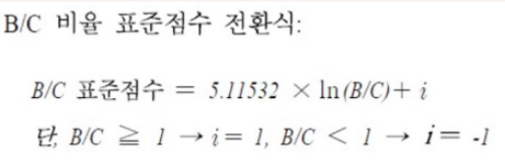
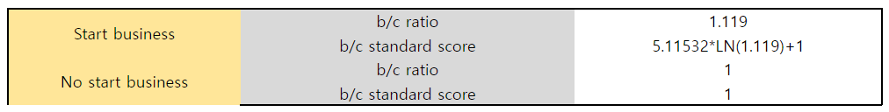
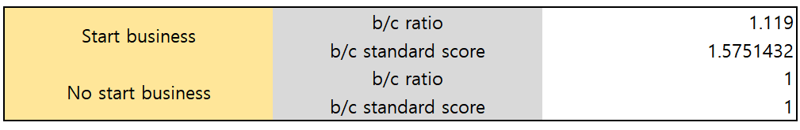
2
Weight
Financial

Slide 72
2
Weight - Seyeon
Technological
Optimize AI > Data analysis > Security
Step 1 | Security | Opimize AI | Data Analysis
Security | 1 | 0.166666667 | 0.25
Opimize AI | 6 | 1 | 2
Data Analysis | 4 | 0.5 | 1
Total | 11 | 1.666666667 | 3.25
Step 4 | Consistency Vector
Security | 3.002393386
Opimize AI | 3.015885624
Data Analysis | 3.009359251
Lambda | 3.009212753
Step 2 | Security | Opimize AI | Data Analysis | Resulting Priorities
Security | 0.090909091 | 0.1 | 0.076923077 | 0.089277389
Opimize AI | 0.545454545 | 0.6 | 0.615384615 | 0.586946387
Data Analysis | 0.363636364 | 0.3 | 0.307692308 | 0.323776224
Total | 1 | 1 | 1 | 1
CI of all | 0.004606377
CR of all | 0.007942029
RI | 0.58
Step 3 | Security | Opimize AI | Data Analysis | Weighted Sum Vector
Security | 0.089277389 | 0.097824398 | 0.080944056 | 0.268045843
Opimize AI | 0.535664336 | 0.586946387 | 0.647552448 | 1.77016317
Data Analysis | 0.357109557 | 0.293473193 | 0.323776224 | 0.974358974

Slide 73
2
Weight - Jeongyun
Technological
Optimize AI > Data analysis > Security
Step 1 | Security | Opimize AI | Data Analysis
Security | 1 | 0.166666667 | 0.25
Opimize AI | 6 | 1 | 3
Data Analysis | 4 | 0.333333333 | 1
Total | 11 | 1.5 | 4.25
Step 4 | Consistency Vector
Security | 3.012528474
Opimize AI | 3.100371747
Data Analysis | 3.049204052
Lambda | 3.054034758
Step 2 | Security | Opimize AI | Data Analysis | Resulting Priorities
Security | 0.090909091 | 0.111111111 | 0.058823529 | 0.08694791
Opimize AI | 0.545454545 | 0.666666667 | 0.705882353 | 0.639334522
Data Analysis | 0.363636364 | 0.222222222 | 0.235294118 | 0.273717568
Total | 1 | 1 | 1 | 1
CI of all | 0.027017379
CR of all | 0.046581688
RI | 0.58
Step 3 | Security | Opimize AI | Data Analysis | Weighted Sum Vector
Security | 0.08694791 | 0.106555754 | 0.068429392 | 0.261933056
Opimize AI | 0.521687463 | 0.639334522 | 0.821152704 | 1.982174688
Data Analysis | 0.347791642 | 0.213111507 | 0.273717568 | 0.834620717

Slide 74
2
Weight - Insun
Technological
Data analysis > Optimize AI > Security
Step 1 | Security | Opimize AI | Data Analysis
Security | 1 | 0.5 | 0.25
Opimize AI | 2 | 1 | 0.2
Data Analysis | 4 | 5 | 1
Total | 7 | 6.5 | 1.45
Step 4 | Consistency Vector
Security | 3.030434783
Opimize AI | 3.061417323
Data Analysis | 3.194848824
Lambda | 3.095566977
Step 2 | Security | Opimize AI | Data Analysis | Resulting Priorities
Security | 0.142857143 | 0.076923077 | 0.172413793 | 0.130731338
Opimize AI | 0.285714286 | 0.153846154 | 0.137931034 | 0.192497158
Data Analysis | 0.571428571 | 0.769230769 | 0.689655172 | 0.676771504
Total | 1 | 1 | 1 | 1
CI of all | 0.047783488
CR of all | 0.082385325
RI | 0.58
Step 3 | Security | Opimize AI | Data Analysis | Weighted Sum Vector
Security | 0.130731338 | 0.096248579 | 0.169192876 | 0.396172793
Opimize AI | 0.261462675 | 0.192497158 | 0.135354301 | 0.589314134
Data Analysis | 0.522925351 | 0.96248579 | 0.676771504 | 2.162182645

Slide 75
2
Weight - Seyeon
Service
Step 1 | Convenience of individual | Saving conversion cost | Expandability
Convenience of individual | 1 | 0.25 | 3
Saving conversion cost | 4 | 1 | 8
Expandability | 0.333333333 | 0.125 | 1
Total | 5.333333333 | 1.375 | 12
Step 4 | Consistency Vector
Convenience of individual | 3.012232416
Saving conversion cost | 3.038869258
Expandability | 3.004
Lambda | 3.018367225
Step2 | Convenience of individual | Saving conversion cost | Expandability | Resulting Priorities
Convenience of individual | 0.1875 | 0.181818182 | 0.25 | 0.206439394
Saving conversion cost | 0.75 | 0.727272727 | 0.666666667 | 0.714646465
Expandability | 0.0625 | 0.090909091 | 0.083333333 | 0.078914141
Total | 1 | 1 | 1 | 1
CI of all | 0.009183612
CR of all | 0.015833814
RI | 0.58
Step3 | Convenience of individual | Saving conversion cost | Expandability | Weighted Sum Vector
Convenience of individual | 0.206439394 | 0.178661616 | 0.236742424 | 0.621843434
Saving conversion cost | 0.825757576 | 0.714646465 | 0.631313131 | 2.171717172
Expandability | 0.068813131 | 0.089330808 | 0.078914141 | 0.237058081

Slide 76
2
Weight - Jeongyun
Service
Step 1 | Convenience of individual | Saving conversion cost | Expandability
Convenience of individual | 1 | 0.333333333 | 4
Saving conversion cost | 3 | 1 | 7
Expandability | 0.25 | 0.142857143 | 1
Total | 4.25 | 1.476190476 | 12
Step 4 | Consistency Vector
Convenience of individual | 3.028197983
Saving conversion cost | 3.062314063
Expandability | 3.007090858
Lambda | 3.032534301
Step2 | Convenience of individual | Saving conversion cost | Expandability | Resulting Priorities
Convenience of individual | 0.235294118 | 0.225806452 | 0.333333333 | 0.264811301
Saving conversion cost | 0.705882353 | 0.677419355 | 0.583333333 | 0.655545014
Expandability | 0.058823529 | 0.096774194 | 0.083333333 | 0.079643685
Total | 1 | 1 | 1 | 1
CI of all | 0.016267151
CR of all | 0.028046811
RI | 0.58
Step3 | Convenience of individual | Saving conversion cost | Expandability | Weighted Sum Vector
Convenience of individual | 0.264811301 | 0.218515005 | 0.318574742 | 0.801901047
Saving conversion cost | 0.794433903 | 0.655545014 | 0.557505798 | 2.007484714
Expandability | 0.066202825 | 0.093649288 | 0.079643685 | 0.239495798

Slide 77
2
Weight - Insun
Service
Step 1 | Convenience of individual | Saving conversion cost | Expandability
Convenience of individual | 1 | 0.333333333 | 0.13
Saving conversion cost | 3 | 1 | 0.25
Expandability | 6 | 5 | 1
Total | 10 | 6.333333333 | 1.38
Step 4 | Consistency Vector
Convenience of individual | 2.976435929
Saving conversion cost | 2.985796133
Expandability | 3.211935344
Lambda | 3.058055802
Step2 | Convenience of individual | Saving conversion cost | Expandability | Resulting Priorities
Convenience of individual | 0.1 | 0.052631579 | 0.094202899 | 0.082278159
Saving conversion cost | 0.3 | 0.157894737 | 0.18115942 | 0.213018052
Expandability | 0.6 | 0.789473684 | 0.724637681 | 0.704703788
Total | 1 | 1 | 1 | 1
CI of all | 0.029027901
CR of all | 0.050048105
RI | 0.58
Step3 | Convenience of individual | Saving conversion cost | Expandability | Weighted Sum Vector
Convenience of individual | 0.082278159 | 0.071006017 | 0.091611492 | 0.244895669
Saving conversion cost | 0.246834477 | 0.213018052 | 0.176175947 | 0.636028477
Expandability | 0.493668955 | 1.065090262 | 0.704703788 | 2.263463005

Slide 78
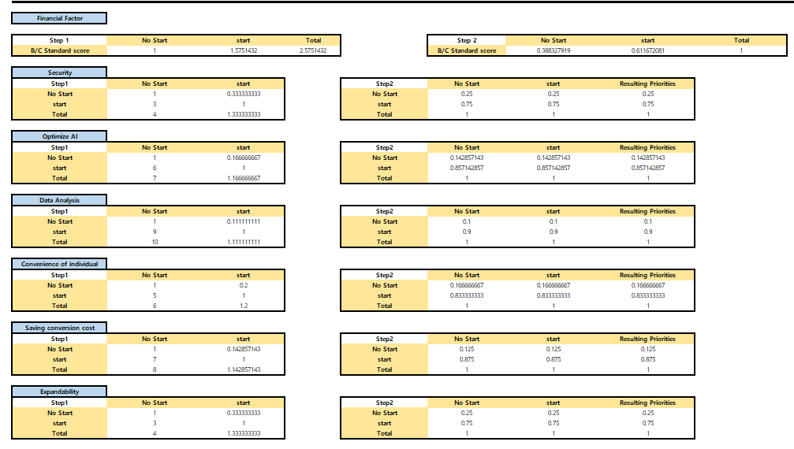
3
Score
Seyeon

Slide 79
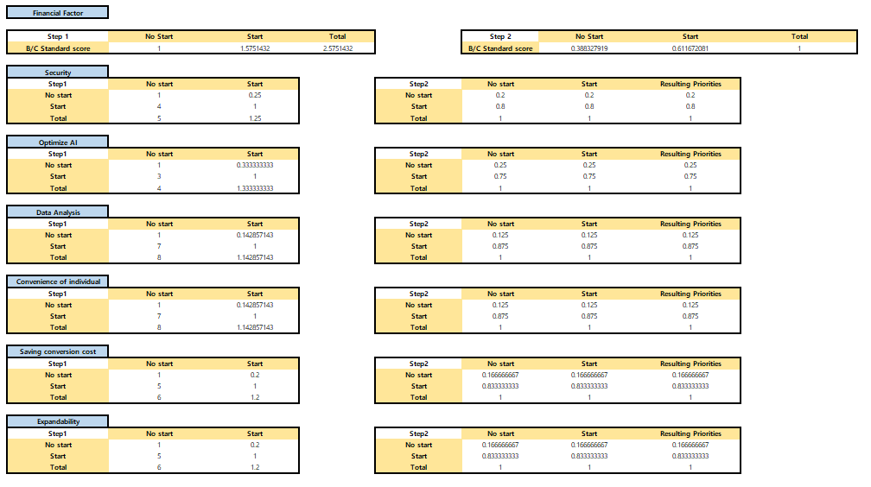
3
Score
Jeongyun

Slide 80
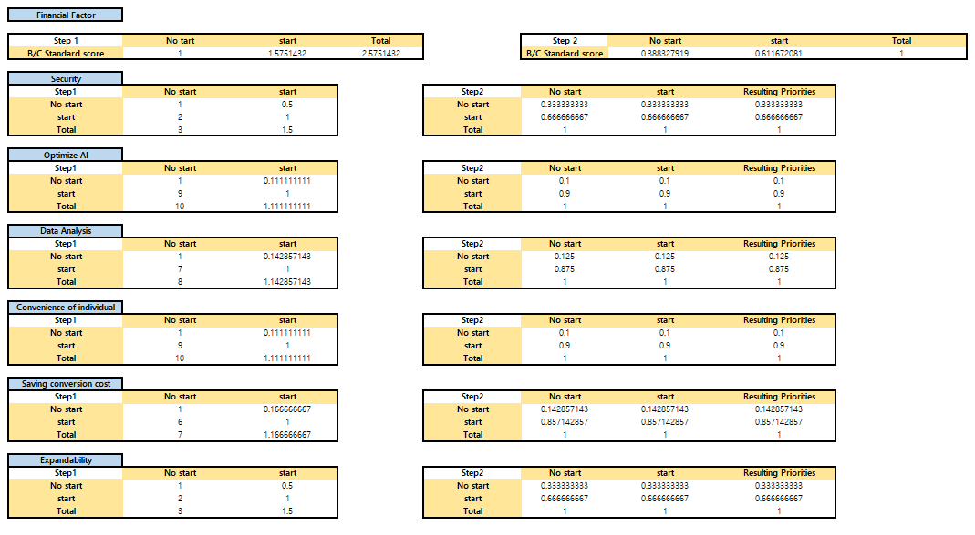
3
Score
Insun

Slide 81
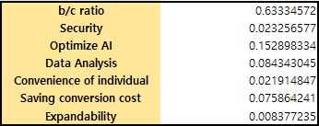
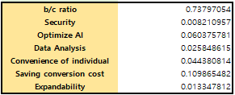
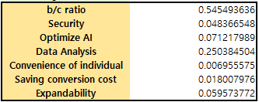
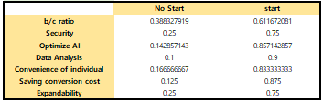
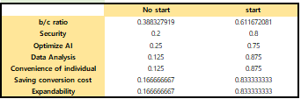
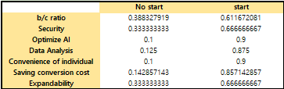
4
Aggregate Final Priorities
*Calculation of weight
Seyeon
Jeong-yun
In-sun
*Calculation of score
Seyeon
Jeong-yun
In-sun

Slide 82

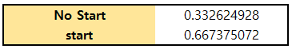
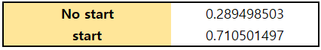
4
Aggregate Final Priorities
*AHP Result = Calculation of weight $×$Calculation of score
Seyeon
Jeong-yun
In-sun

Slide 83
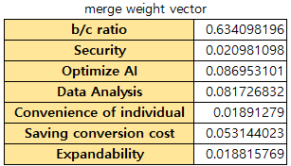
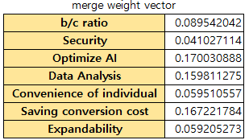
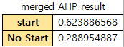
4
Aggregate Final Priorities
Merged Result
No start < Start

Slide 84
4
Aggregate Final Priorities
AHP result
 | AHP<0.45 | 0.45<=AHP<0.5 | 0.5<=AHP<0.55 | 0.55<=AHP
3 : 0 | - | - | Valid | Valid
2 : 1 | Feedback | Very Cautious | A Bit Cautious | Valid
1 : 2 | No Validity | A Bit Cautious | Very Cautious | Feedback
0 : 3 | No Validity | No Validity | - | -
Total
Start : No start
Starting Our Business is Valid Choice.

Slide 85
Thank you
Co-Sub
Co-Sub
21102052 Lee Jeong-yun | 21102044 Oh Seyeon | 21102050 Lee In-sun

